Slide 1
Welcome to Year 3
September 2022

Slide 2
Welcome to our year group
We are here to work in partnership with you to achieve the best for your child.
If you have any concerns, please let your child’s class teacher know.
The next port of call would be to communicate with the Year Group Leader, Mrs Campbell. Thank you.

Slide 3
Vision Statement
We are a dynamic, diverse and inclusive community of lifelong learners, where children are nurtured and supported to achieve their potential and to become responsible citizens who can make a difference in the world.

Slide 4
Our School Values

Slide 5
Upholding British Values

Slide 6
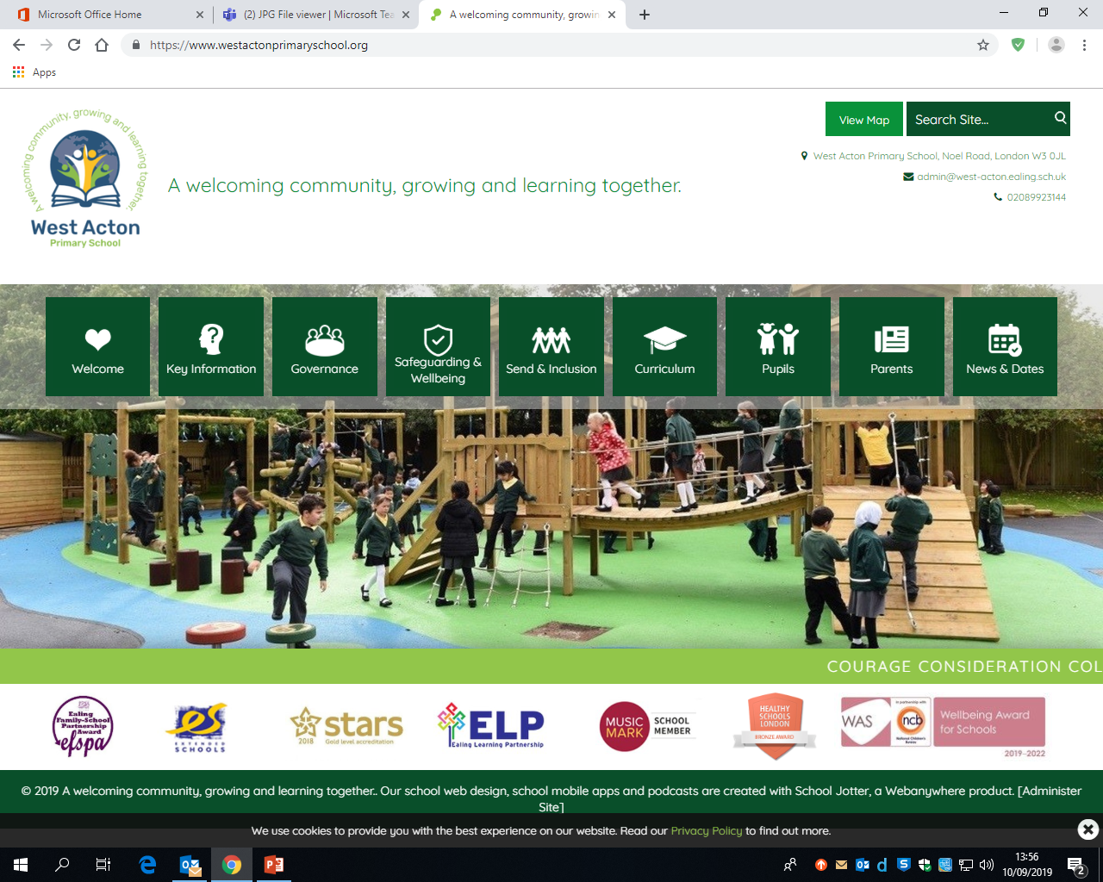
School website & app
http://www.westactonprimaryschool.org/

Slide 7
What should be brought in everyday?
Book bag with home reading book and reading record/planner
Water bottle
Healthy snack for morning break – fruit or vegetables only
Outdoor clothing - depending on weather, this could be a raincoat, a winter coat or a cap, for example

Slide 8
Uniform
School Uniform | PE Uniform
Grey Trousers or Shorts | White t-shirt
Grey Skirt or Pinafore (Girls) | Black Shorts or Tracksuits
Green Checked Dress (Girls) | White/Black Plimsolls for indoor PE
White shirt (long or short sleeve) | Trainers for outdoor PE
West Acton Fleece or Jumper | Sun Safety (Optional)
Black School Shoes | Green Baseball Cap or Floppy Hats
Grey/White/Black Socks. Grey or black tights. No leggings
Black/White or Green Headscarf
It is useful for every item of clothing to be labelled - thank you.

Slide 9
PE Kit
As with borough policy, no jewellery is allowed to be worn to ensure the safety of the children. Long hair should also be tied back out of eyes.
Children need to come to school wearing their PE kit (dark shorts/ tracksuits and white t-shirts) every Wednesday. If the weather is cold, they would wear their school jumper, cardigan or fleece.

Slide 10
Enrichment Lesson Teachers on PPA day
Physical Education (P.E.) teacher: Mr Gallagher
Spanish teacher: Senora Marquez-Garcia
Music teacher: Miss Avlianos and Miss Ramshaw
These lessons will take place every Wednesday from 11:45 till lunch and then for the rest of Wednesday afternoons.

Slide 11
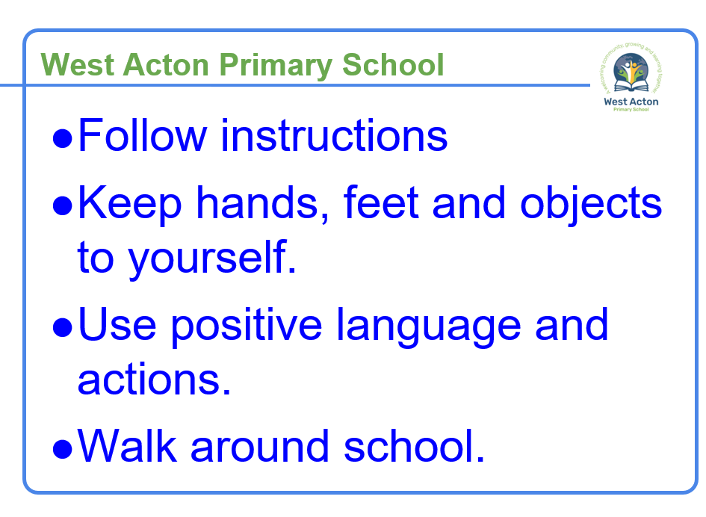
Behaviour
We want every child to feel safe and secure at West Acton Primary School, so that they can be happy, enjoy learning and make great progress in their learning and development. To support this culture for a love of learning that fits in with our school values and British values, we have 4 simple school rules that focus on a positive reinforcement approach for all learners:
Award of house points for good work, attitude and behaviour.
Celebration of good work using wristbands sent home.
Positive comments and praise.
Values awards

Slide 12
What will be different in Key Stage 2?
Year 3 is an important year. Your child is transitioning into Key Stage 2 and will aim to be in line with age-related national expectations or to work at a greater depth level of learning to develop good learning habits and to help them to be on track as they progress through Key Stage 2 when they will have their end of Key Stage 2 SATs in Year 6. That seems a long way away, but we are building the foundations for that attainment and progress now. We undoubtedly appreciate your support in this as we work together in partnership with you to achieve the best for your child.
Some changes from Key Stage 1 will include:
One morning break (15 minutes) and an hour for lunch, with no afternoon break.
Healthy fruit and vegetable snacks are not offered by school in Key Stage 2 – these will need to be brought in daily from home.
Use of a wider area of the playground and mixing with Year 6 pupils at break.
No ‘carpet time,’ as pupils will be sat at desks for teacher input.
Longer morning sessions, as break will be at 11:00 at lunch will be at 12:30.

Slide 13
What will your child be learning?
Themed learning topics will be taught each term, including:
The Stone Age (History, Autumn 1)
The Bronze Age to the Iron Age (History, Autumn 2)
Food Journeys – World Kitchen (Geography, Spring 1)
Climate and Weather (Geography, Spring 2)
Romans (History, Summer 1)
Coasts (Geography, Summer 2)
We cover the National Curriculum Subjects for Key Stage 2. Our lessons include: English, Maths, Reading, Handwriting, Spellings, Humanities (History and Geography), Science, Art, Design Technology (DT), Personal Social Health an Economic Education (PSHE), Religious Education (RE), Spanish, Physical Education (PE), Music, Collective Worship and Computing.
Every half term, our curriculum overview is updated and is available on the Year 3 curriculum page of the school website. The Autumn 1 curriculum overview is available…

Slide 14
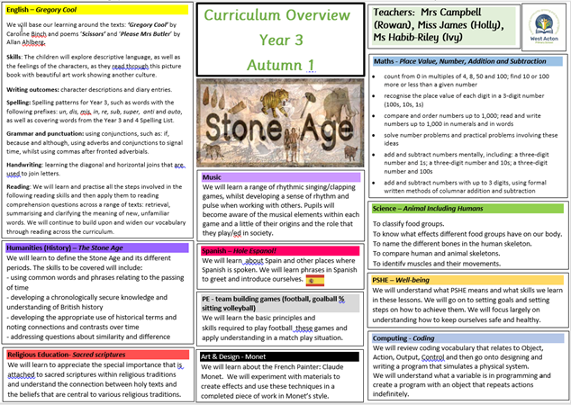
Autumn 1 Curriculum Overview

Slide 15
Weekly Timetable Example

Slide 16
Soft Starts
Children must be in the classroom by 8:55 for registration.
At 8:55, the school gates should close and pupils must enter via the school office and may be marked as late.
Support staff are in key areas to welcome pupils and take important messages to teachers.
The register closes at 9:00 and lessons start promptly.
Pupils are encouraged to be in school from 8:45 for a ‘soft start’ to the day.
This ensures a calm and structured start to the day.
This means that they have time to be welcomed by staff; put their belongings away; settle at their desks; see the visual timetable on the board, so they are aware of the structure of the day; have a chance to check in with the class teacher about any queries and do a warm up learning activity, so that they are fully engaged and focused for lessons that start at 9:00.

Slide 17
Pick up at home-time
Pick up time at the end of the day is 3:15pm
If you are unable to pick up your child and have arranged someone else to do this, or will be late, please let the school know as soon as possible.
Pupils must tell their teacher that they are leaving at the end of the day, with their adult and wait for the teacher to dismiss them.
It would be useful for teachers to be able to give you brief, informal feedback about your child on occasion at home-time.
If you would like to talk to the Class Teacher or Year Group Leader, please wait for a quiet moment, such as when the rest of the class has been collected.
Please look out for key messages stuck on Year 3 classroom doors.

Slide 18
Home Learning Weekly homework includes: Spellings – learn to spell and write sentences for Reading – 20 minutes at least 5 evenings a week Times tables practice (2,5,10,3,4,8) Mental maths games (Hit the Button) www.topmarks.co.uk CGP books Additional learning: Espresso log ins Purple mash Sumdog

Slide 19
Reading Records
We encourage a love of reading and understand that reading is the foundation for all learning. Therefore, pupils are expected to read at least 5 times a week at home for 20 minutes from their home reading book, which matches their reading level. One of these homework sessions should involve reading from a levelled book on our online reading comprehension program, Bug Club.
Reading with your child daily will make a huge difference to all of their learning attainment and progress.
Please comment and sign your child’s Reading Record daily, so we can monitor your child’s progress.
Reading Records and home reading books are to be brought into school every day.
Mrs Iwanczuk will be choosing books with the children and commenting in their Reading Record through the week. This will be on Mondays for Rowan Class, Thursdays for Ivy Class and Fridays for Holly Class.
Reading is part of the Year 3 homework each week, 5 times a week.

Slide 20
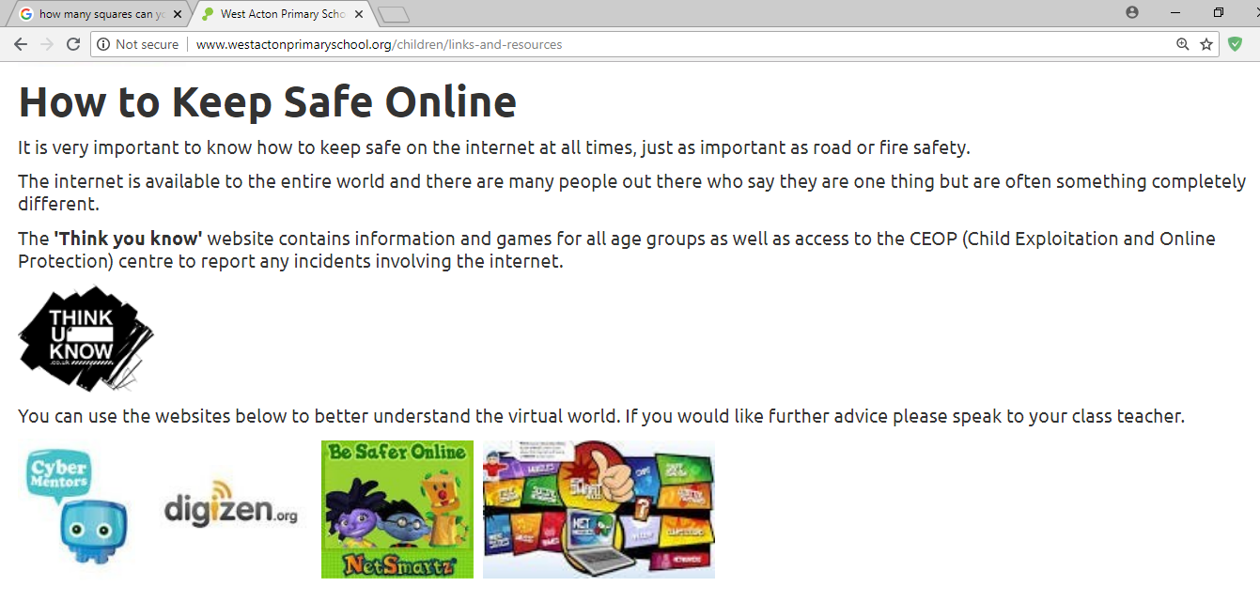
E-Safety
https://www.nspcc.org.uk/preventing-abuse/keeping-children-safe/online-safety/
https://www.saferinternet.org.uk/advice-centre/parents-and-carers
Did you know?
A child who only has 1 hour screen time on the weekends is more likely to achieve their learning goals!
Please be vigilant on what games your child is playing online. They should be age appropriate and parental guidance is strongly advised.

Slide 21
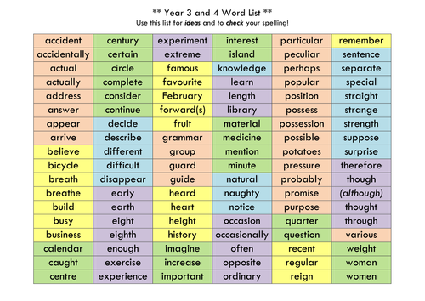
Spellings
Children in Year 3 and 4 are expected to know how to spell the following words.
These words can be found online, on our school website and in your child’s Reading Record.

Slide 22
How the school communicates with you
Informal chat at the end of the day
Reading Record messages
Newsletter at the end of each week
Reminder and information letters
Termly curriculum overviews
Termly year group letters, including English updates
Display screens in office, playground and on Year 3 classroom windows/doors
Website and school mobile app
Text messages
Various workshops and meetings

Slide 23
Things to keep in mind
Finally, keeping in mind that your child will work hard at school, they will need a lot of sleep. Ensuring children have regular bedtime routines with about 10 to 11 hours sleep every night would help their learning and development tremendously.
Scientific research shows that it is important for people to not use an electronic screen device up to an hour before bed-time to ensure good sleep.
Developing bed-time routines where pupils read their school library book or one of their own books from home, is good for developing a love of reading whilst calming the mind down and, thus, allowing better sleep. Scientific research shows that this helps mental well-being, hugely!
Children are never to old to be red to at bed-time too!
It is also essential that pupils have a healthy breakfast every morning, so they can concentrate and achieve their best.
Lunch time isn’t until 12:30, so they will need a healthy snack for break, which is at 11:00.

Slide 24
Thank you for supporting your child’s learning – together, we can make a difference. If you have any questions, please email: admin@westacton.ealing.sch.uk Address your email to the class teacher. Thank you.

